Slide 1
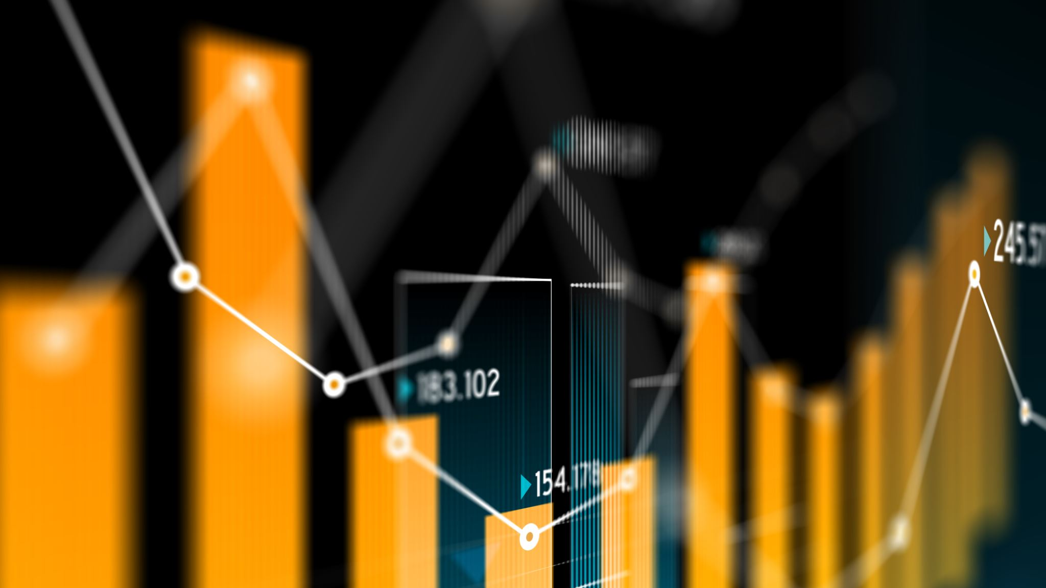
Basic Statistics with Power BI for Data Translators
GemRain Consulting Sdn Bhd

Slide 2
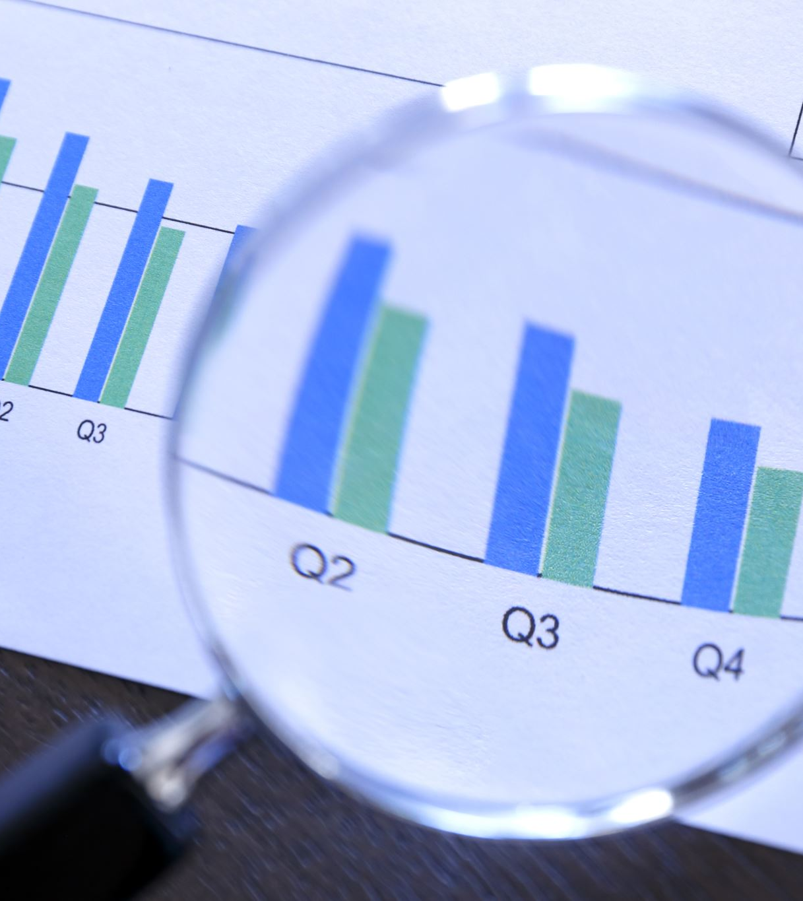
MILESTONE 1 AGENDA
What is statistics?
How does basic statistics help data translators?
Typical skills & key responsibilities
Measures of central tendency
Regression analysis
Clustering analysis
Forecasting

Slide 3
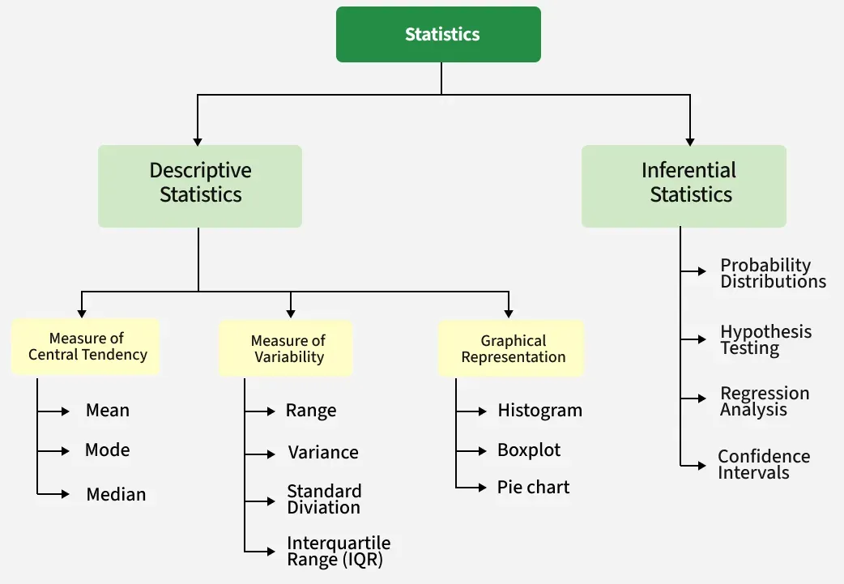
What is statistics?
Statistics (often descriptive) is an analytical approach that summarizes or describe features of a data set
This knowledge is extremely important to understand your data set prior to any deeper analysis that would be required
The step of understanding your data set is known as “Exploratory Data Analysis” (EDA)

Slide 4
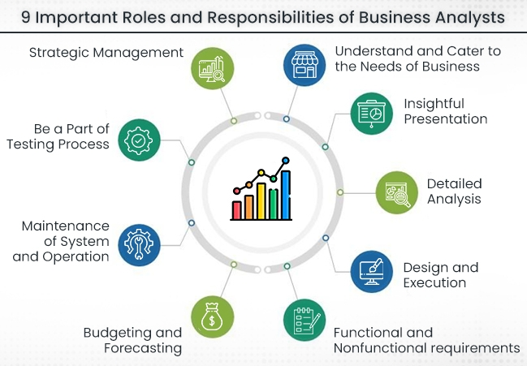
Important roles & responsibilities of data translators / business analysts
More to be covered in data storytelling course

Slide 5
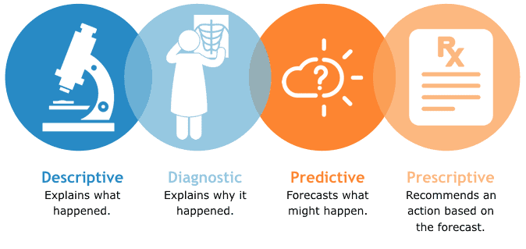
Types of Data Analysis

Slide 6
Measures of central tendency
Measures of central tendency is the statistical measure that identifies a single value as representative of an entire distribution
Arithmetic Mean
Mean (x̄)
Harmonic Mean
Weighted Mean
Measures of central tendency
Median
Mode

Slide 7
Measures of central tendency
 | Arithmetic mean | Median | Mode
What | Average | Middle value in a sorted list (typical) | Most occurred value
Why | It denotes the equal distribution of values for a given data set | It's a more robust measure than the mean (average) because it's less sensitive to outliers and skewed distributions | Identify the most common or typical value in a set of data
When | Used when the data is symmetrical and doesn't have extreme outliers. It's a good representation of the typical value in such cases | Used when the data is asymmetrical and have outliers | The mode is particularly useful for categorical data, where you want to know the most common category or label
In business | “What is the monthly average revenue from Region A for 2025?” | “What is the typical purchase value per customer?” | “Which product category that has the most order in Q1Y25?”
How | Sum of all values and divide total number of values | Sort the list of values and find the middle value | Count occurrence of each value and find the value with highest occurrence
DAX* | AVERAGE(‘table’[Value]) | Refer to DAX Patterns below | Refer to DAX Patterns below

Slide 8
CLU1 – Arithmetic Average
Company X sells homewares in Region A. The sales records for each month are as follow: Jan-25 : $400 Feb-25 : $300 Mar-25 : $320 Apr-25 : $430 May-25 : $440
Calculate the average sales in Region A for YTD 2025.

Slide 9
CLU2 – Median
In a typical week of sales for Company B, the sales records are recorded as follow: Week 1 : $850 Week 2 : $320 Week 3 : $370 Week 4 : $130
What is a typical sales per week for Company B?
What is the average weekly sales for Company B?
Which would make more sense for business analysis – median or average? Explain.

Slide 10
CLU3 - Mode
During the durian season, a durian seller could sell an average of 200pcs per week. Below is the quantity sold in a typical week:
Mon : 50pcs
Tue : 30pcs
Wed : 60pcs
Thu : 50pcs
Fri : 20pcs
What is the most repeated order quantity?

Slide 11
About harmonic mean & weighted mean
 | Harmonic mean | Weighted mean
What | The harmonic mean is the reciprocal of the arithmetic mean of the reciprocals of a set of numbers. It’s a type of average that gives more weight to smaller numbers. | The weighted mean multiplies each value by a weight, then divides the total of these products by the total of the weights. It prioritizes some values more than others.
Why | Use it when averaging rates or ratios where the denominator matters more, like speed, efficiency, or price per unit. It reduces the impact of large outliers | Use it when some values contribute more to the result than others—common in performance ratings, polling, and combined indexes
When | Used when data presented are in reciprocals (e.g.: speed, PE ratio) | Used when certain values within a dataset are considered more important or influential than others
In business | “What is the average PE ratio in the past 5 years for Company A?” | “What is the average cost of goods sold to be recognized in the financial statements?”
How | Take the reciprocal of each value and compute the average | Multiply each value by its corresponding weight, sum the products, then divide by the sum of weights
DAX* | Harmean = VAR n = CountRows('table’) VAR d = SUMX('table', 1/[Uses]) RETURN DIVIDE(n, d) | Weighted Mean = VAR WeightedValues = SUMX(‘table', ‘table'[Value] * ‘table'[WeightValue]) VAR TotalWeights = SUM(‘table'[WeightValue] ) RETURN DIVIDE(WeightedValues, TotalWeights)
*The use of variables (VAR) in DAX will be covered in-depth in GRC102 Conquering DAX

Slide 12
CLU4 – Harmonic mean
Company C is a public listed company. In the past 5 years, below are the Price/Earnings (PE) ratio:
Year 1 : 5.38
Year 2 : 9.63
Year 3 : 13.5
Year 4 : 10.5
Year 5 : 17.4
What is the average PE ratio in for this 5-year period?

Slide 13
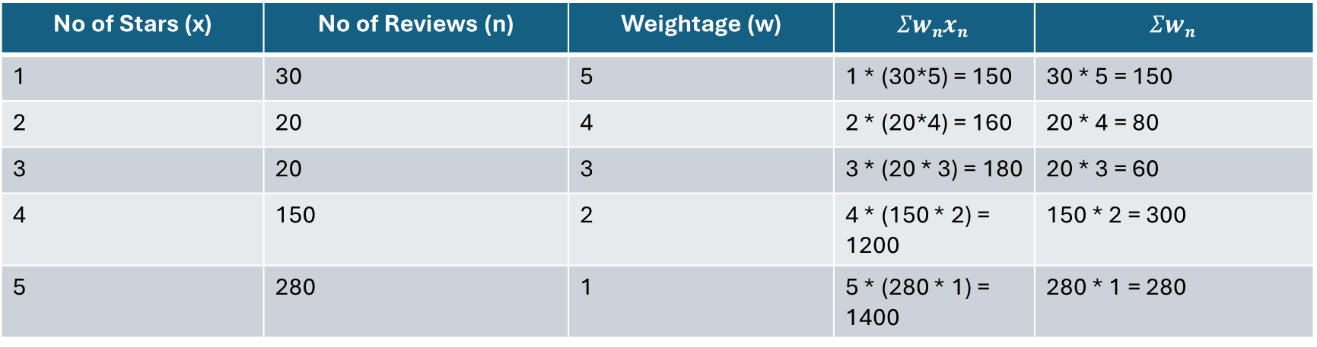
CLU5 – Weighted mean
Mr. Alif recently started becoming a Grab driver. There are 500 passengers who gave him reviews, from 1 star to 5 stars. Mr Alif decides to get your help to understand his average rating. He claims that to recover a 0.1 drop of rating, he’d need to get 100 passengers rating him 5 stars.
What is the average rating for Mr. Alif?
No of Stars (x) | No of Reviews (n) | Weightage (w) | $$Σwnxn$$ | $$Σwn$$
1 | 30 | 5 | 1 * (30*5) = 150 | 30 * 5 = 150
2 | 20 | 4 | 2 * (20*4) = 160 | 20 * 4 = 80
3 | 20 | 3 | 3 * (20 * 3) = 180 | 20 * 3 = 60
4 | 150 | 2 | 4 * (150 * 2) = 1200 | 150 * 2 = 300
5 | 280 | 1 | 5 * (280 * 1) = 1400 | 280 * 1 = 280

Slide 14
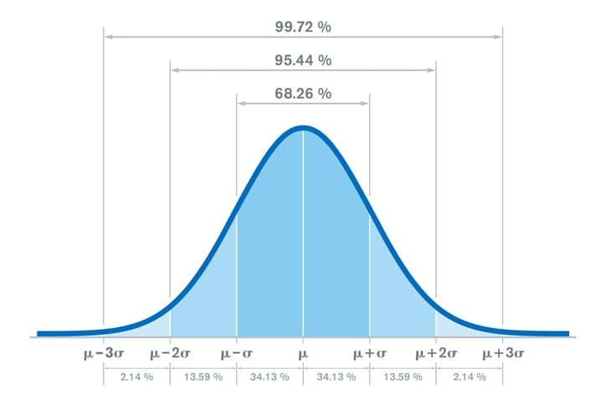
What is a “normal” distribution?
Normal distribution, also known as the Gaussian distribution, is a probability distribution that is symmetric about the mean, showing that data near the mean are more frequent in occurrence than data far from the mean (μ)
Standard deviation (σ) is also equally spread around the curve on both sides
In a normal distribution curve, mean = mode = median

Slide 15
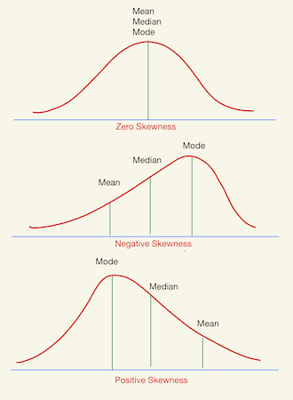
About standard deviation (σ) and kurtosis
Standard deviation is a statistical measure that describes the spread of data around its mean (average)
A low standard deviation indicates that data points are clustered tightly around the mean, while a high standard deviation means they are more spread out
Understanding the distribution of data points help to identify if average or median would be best suited to answer business questions

Slide 16
LAB 1A: Applying measures of central tendency to a copper wire production dataset
Credits to Oscar, Kaggle (2021)
Context
This dataset was taken from a copper production line in November 2020. The purpose of the job was to find the root cause of an increasing number of defects in a copper production line.
Content
The data includes the dates and shifts for each inspection, the type of defect, and the production downtime in minutes per type of defect. This file compiles all the failures in a copper wire production line for 1 month.
Metadata (definition)
Machine: machine number used – all machines are the same type
Shift: AM, PM
Cable failures: Failures specifically related to cable breaking while spinning it
Downtime: time lost in minutes

Slide 17
LAB 1A: Applying measures of central tendency to a copper wire production dataset
Your task
As a business analyst, your task is to understand the main root cause of process failures by distinguishing the contributions from different sources: human related failure (operators and supervised vs unsupervised work, there are no supervisors on weekends), machine related failure (one machine failing more than others), raw material failure (related to cable failures) and other factors included in the other category.
Technical brief
Create the following DAX measures
Avg of cable failure downtime
Median of cable failure downtime
Max of cable failure downtime
Non-zero Min of cable failure downtime
Note: When dealing with a lot of DAX codes, it is advisable to create measures folder simply by first create a blank table from Home > Enter data

Slide 18
LAB 1A: Applying measures of central tendency to a copper wire production dataset
Discussion
What other areas can be analysed from the given dataset?
What can be communicated to stakeholders to obtain clearer insights?

Slide 19
Regression analysis (ŷ)
Regression analysis is a statistical method used to understand and quantify the relationship between a dependent variable and one or more independent variables
It helps determine how changes in independent variables are associated with changes in the dependent variable, allowing for predictions and insights into cause-and-effect relationships
There are 3 common classes of regression models:
Simple regression model
Auto-regression (regress one dependent variable over time)
Multi-variate regression model

Slide 20

Simple Linear Regression Model
Simple linear regression is a statistical method that allows us to summarize and study relationships between two continuous (quantitative) variables:
Independent variable, x (aka predictor, explanatory)
Dependent variable, y (aka response, outcome)
Simple linear regression gets its adjective "simple," because it concerns the study of only one predictor variable.

Slide 21
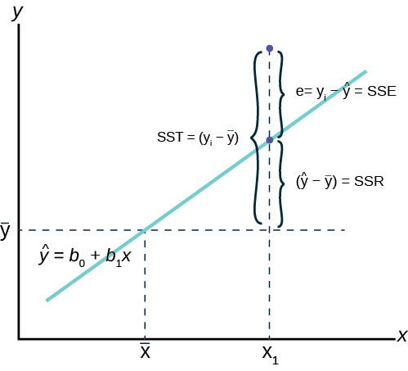
Simple Linear Regression Equation
The formula contains an error term (𝜀) but is often ignored (in business practice) because the prediction model focuses on expected value of y given x
When a linear correlation is established, simple regression model is a powerful predictive tool
E.g.: what is the projected revenue in Q3Y25 given there are similar trends for the past 6 quarters?
SST (sum of squares total), SSR (sum of squares regression or sum of squares mean), and (𝜀) would not be covered in-depth in this course

Slide 22
LAB 1B: Calculating simple regression model of copper wire production dataset
Credits to Oscar, Kaggle (2021)
Context
The production manager is hypothesizing the “other failures” may have a positive correlation with cable failures (e.g.: raw material failures causes the cables to break when spinning it)
Your task
Identify the dependent and independent variable
Establish a simple regression model using DAX table with LINESTX function
Note: Further reading here

Slide 23
LAB 1B: Calculating simple regression model of copper wire production dataset
Discussion
With a negative slope, is this:
Direct relationship between two variables
Inverse relationship between two variables
Neither (insufficient to conclude with just slope value/gradient as information)
If the information is insufficient, what else would be required to assess the relationship between these variables?

Slide 24
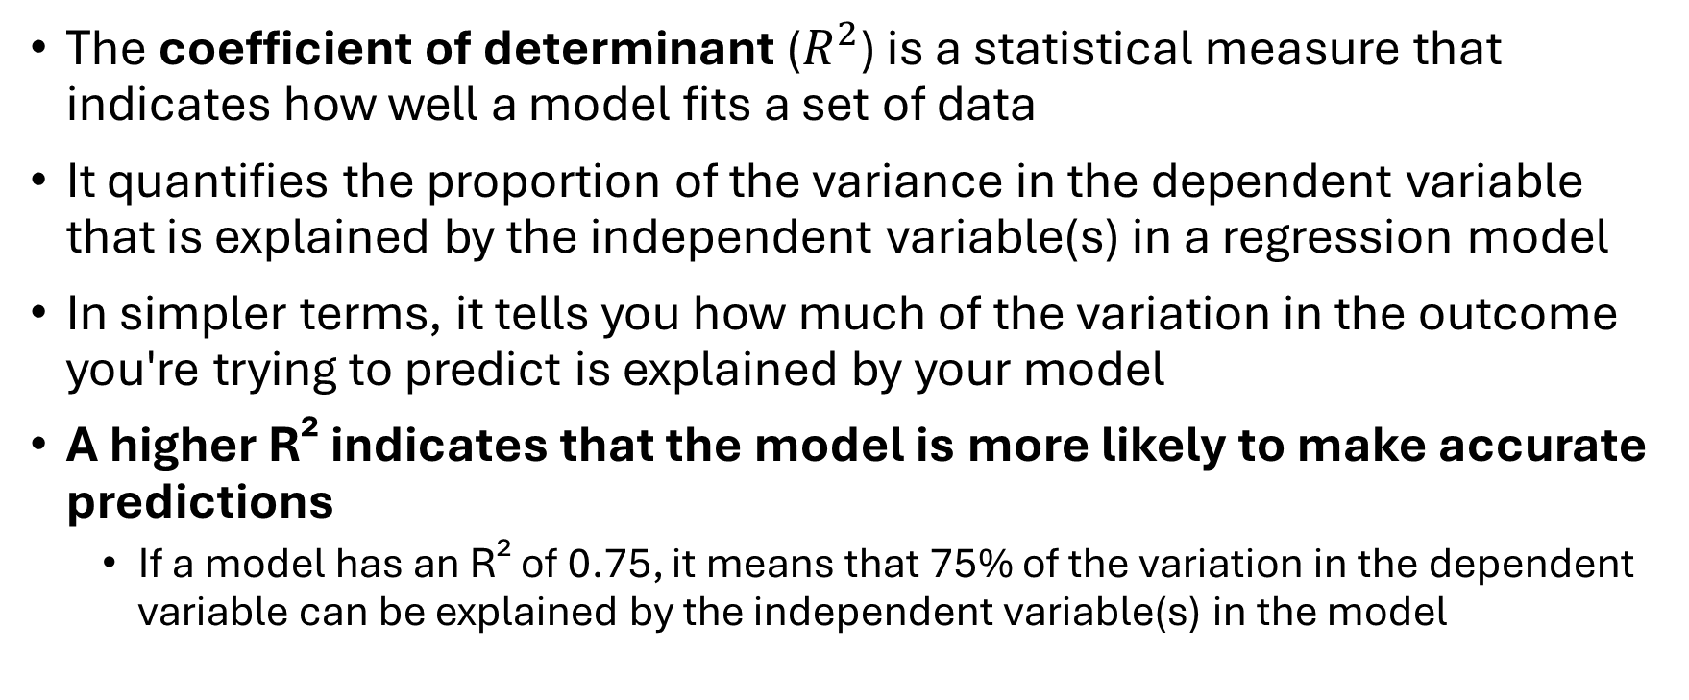
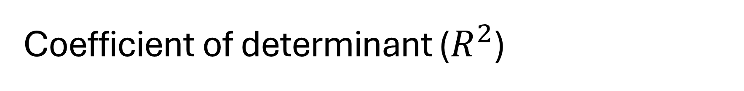
Coefficient of determinant ($R^{2}$)
The coefficient of determinant ($R^{2}$) is a statistical measure that indicates how well a model fits a set of data
It quantifies the proportion of the variance in the dependent variable that is explained by the independent variable(s) in a regression model
In simpler terms, it tells you how much of the variation in the outcome you're trying to predict is explained by your model
A higher R² indicates that the model is more likely to make accurate predictions
If a model has an R² of 0.75, it means that 75% of the variation in the dependent variable can be explained by the independent variable(s) in the model

Slide 25
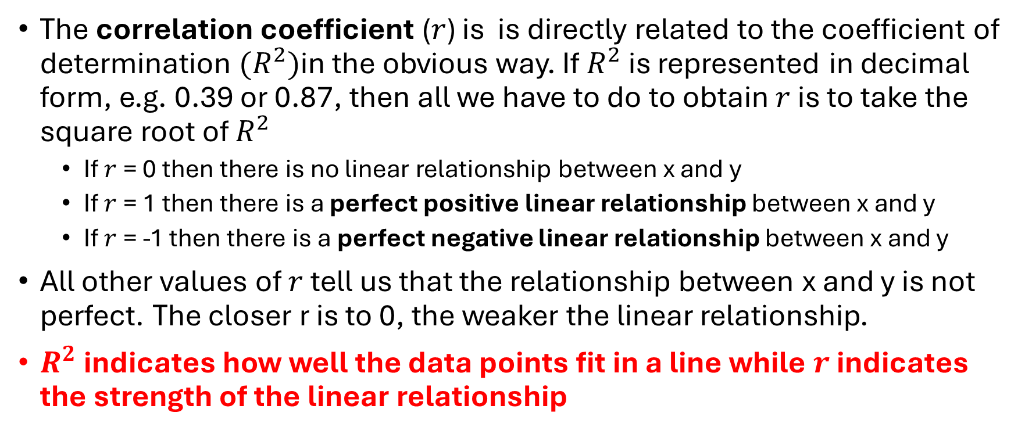

Correlation coefficient ($r$)
The correlation coefficient ($r$) is is directly related to the coefficient of determination ${(R}^{2})$in the obvious way. If $R^{2}$ is represented in decimal form, e.g. 0.39 or 0.87, then all we have to do to obtain $r$ is to take the square root of $R^{2}$
If $r$ = 0 then there is no linear relationship between x and y
If $r$ = 1 then there is a perfect positive linear relationship between x and y
If $r$ = -1 then there is a perfect negative linear relationship between x and y
All other values of $r$ tell us that the relationship between x and y is not perfect. The closer r is to 0, the weaker the linear relationship.
$R^{2}$ indicates how well the data points fit in a line while $r$ indicates the strength of the linear relationship

Slide 26
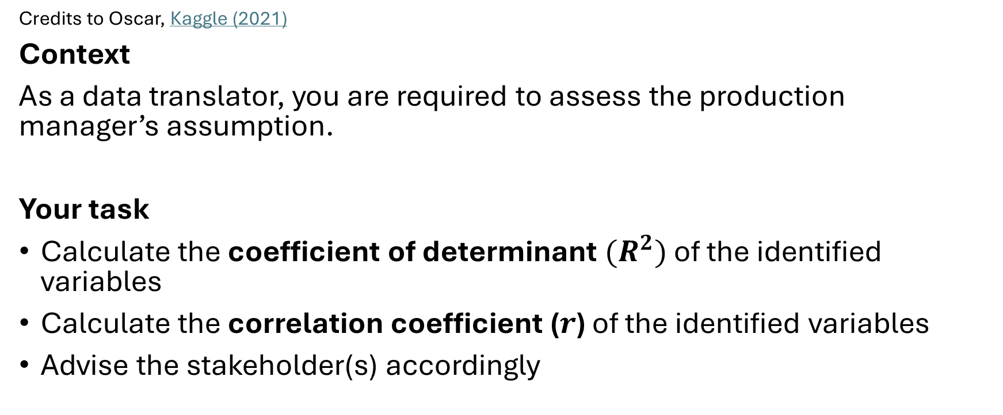
LAB 1C: Calculating coefficient of determinant and correlation coefficient of copper wire production dataset
Credits to Oscar, Kaggle (2021)
Context
As a data translator, you are required to assess the production manager’s assumption.
Your task
Calculate the coefficient of determinant ${(R}^{2})$ of the identified variables
Calculate the correlation coefficient ($r$) of the identified variables
Advise the stakeholder(s) accordingly

Slide 27

Clustering vs classification
Clustering is a type of unsupervised learning, where the goal is to group similar data points together based on their features, without using labels
It’s like sorting a mixed box of buttons by size and color — but the algorithm figures out the groups on its own
K-means is a classic clustering algorithm, where a centroid and k (the number of clusters) are defined
k-NN (k-nearest neighbors) is a supervised learning algorithm, usually used for classification or regression, not clustering.

Slide 28
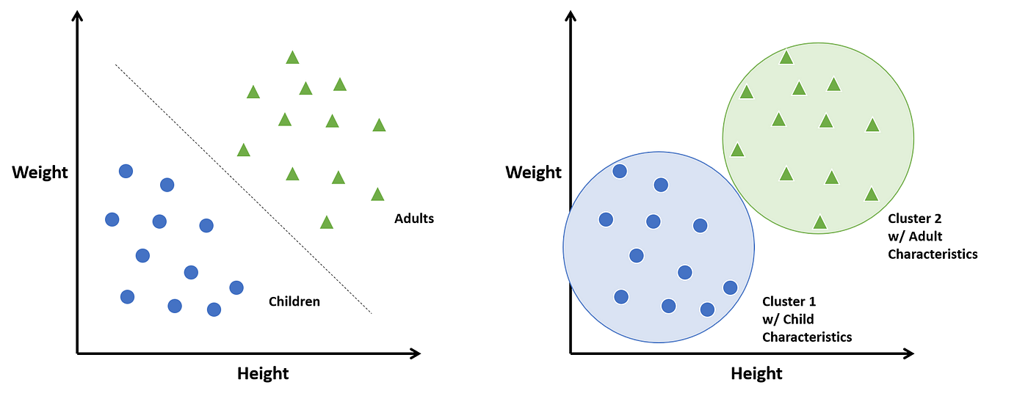
Classification (k-NN)
Clustering (k-means)

Slide 29
K-NN algorithm at work: Geo-clustering case study
Context
A popular carbonated beverage brand in Singapore wants to study the footfall traffic across all 20k outlets in the country. The objective is to identify suitable psycho-demographic regions for pilot tests. Unlike Malaysia demographics, there are no strict “regions” in Singapore in the Stores table.
Work done
A third-party vendor was engaged to collect survey data every quarter
Post data cleansing and modeling in Power BI, the outlets geocodes (latlon) were clustered using k-NN algorithm in Python to determine the 4 clusters in Singapore, thereby defining the regions of that country.

Slide 30
K-means at work: Lookalike (LAL) Marketing Case Study
Context
Facebook marketing uses LAL algorithm to engage with wider audience in the network. This is usually leveraged by businesses during marketing outreach campaigns to gather more leads.
One of the world’s largest alcohol beverage brands in Malaysia engaged a marketing agency to manage the outreach campaigns to strengthen their digital presence
Work done
A threshold LAL % was determined, monitored and iterated over time before reaching that “sweet spot” of marketing outreach
For more info, visit Facebook article on Lookalike Audiences

Slide 31
Forecasting
Forecasting is the process of predicting future events or outcomes by analyzing past data and identifying trends
It's used to anticipate changes in the future, making informed decisions, and planning for potential challenges
Typical work functions that rely on forecasting:
Supply Chain - Supply & demand planning management
Sales forecast (some companies call this pledging/commitment)
Financial forecast (some companies use rolling forecast)*
How weather forecasts affect the sales forecast of seasonal items**
*Financial modelling and forecasting methods will not be covered in this module
**Multivariate time series forecast will not be covered in this module

Slide 32
Simple Linear Regression as a Forecasting Tool
When x is an independent variable apart from time, and a simple linear regression fits the data sample for that given period, y can be easily obtained using the linear equation formula
An energy audit team models daily electricity usage (kWh) based on the number of people present in the office:
Usage = 1.8 × Number of People + 50
What’s the expected electricity use if 25 people come to work?

Slide 33

Simple Moving Averages (SMA)
A simple moving average (SMA) is a method to smooth out short-term fluctuations in data and highlight longer-term trends or cycles. It is commonly used in time series analysis — like stock prices, sales data, website traffic, etc.
You pick a window size (e.g., 3, 5, or 7 time periods), and for each point in time, you calculate the average of the last n values
Simple: Each value in the window is equally weighted
Lagging: It reacts slowly to changes because it smooths the data
Used for: Trend detection, noise reduction*, forecasting inputs
*Noise reduction, or smoothing will not be covered in this course

Slide 34
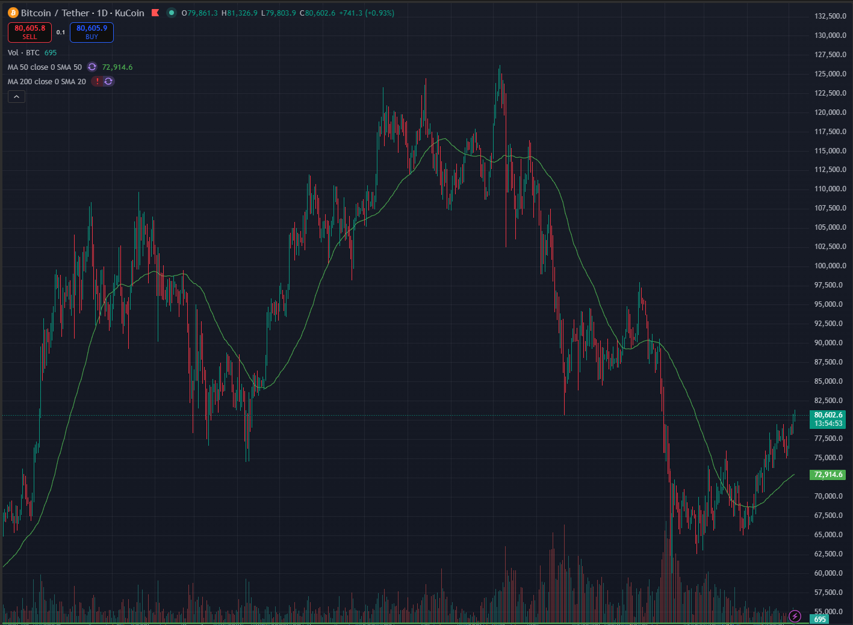
SMA in action
The thin green line shows SMA(50)
Source: Trading View for BTC/USDT

Slide 35
Weighted Moving Averages (WMA)
A weighted moving average (WMA) is a variation of the simple moving average where more recent data points are given more importance (weight) than older ones
Another alternative would be exponential moving average (EMA) that uses alpha-coefficient
It’s used when newer values are more relevant for trend detection or forecasting
Applications include:
Forecasting sales where recent weeks matter more
Stock price analysis with short-term sensitivity
Inventory demand prediction
*EMA and alpha-coefficient will not be covered in this module as it is often lacking a sound business justification compared to SMA and WMA

Slide 36
LAB 2: Forecasting retail sales value of beverages
Context
This dataset was taken from a retail sales & warehouse sales of Prima chain, a group of outlets in Malaysia from Jan-Jun 2024. As a business analyst under “Beverages”, you are required to produce forecast from July-Dec 2024.
The datasets cover all non-alcoholic beverages with various categories.
Your task
Assess if the entire dataset is necessary for the forecast
Construct a regression line for “Soda” category sales and assess if this model is a good fit
Determine the n-periods for forecasting using SMA and WMA

Slide 37
MILESTONE 2 AGENDA
Milestone 1 recap
Model-driven data exploration in Power BI using SDG datasets
Exploratory Data Analysis (EDA) using Power BI using SDG datasets
Applying business logics for RFM analysis

Slide 38

Setting expectations from this module onwards…
Advance warning
You are about to enter intermediate DAX & data modeling principles zone – ensure full focus from this point onwards when you see this
KONTRAKTOR: Alex Ooi
alex@gemrain.net
Slow down
This is a new concept in DAX which requires your full participation. Stop the trainer when in doubt before moving on!
Checkpoint
Housekeeping rules will be revisited. Ensure certain features are already enabled; if not enabled, please enable them, close the Power BI Desktop app and reopen for the changes to be reflected

Slide 39
DAX Patterns – Averages
5 muka surat
KONTRAKTOR: Alex Ooi
alex@gemrain.net
ARITHMETIC MEAN
Arithmetic Mean =
AVERAGE('table’[Column])
HARMONIC MEAN
Harmean =
VAR n = CountRows('table’)
VAR d = SUMX('table', 1/[Uses])
RETURN
DIVIDE(n, d)
WEIGHTED MEAN
Weighted Mean =
VAR WeightedValues = SUMX('table', 'table'[Value] * 'table' [WeightValue])
VAR TotalWeights = SUM(‘table'[WeightValue] )
RETURN
DIVIDE(WeightedValues, TotalWeights)
Further reading on VAR: https://radacad.com/dax-variables-better-readability-consistency-and-performance-in-power-bi-calculations/

Slide 40
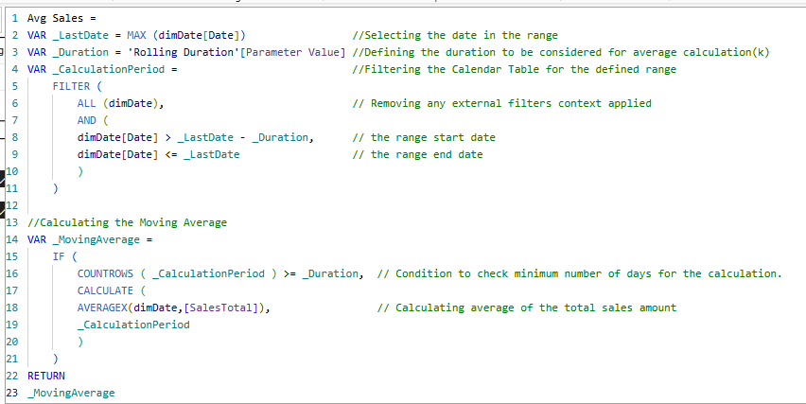
DAX Patterns – Simple Moving Average (Bounded)
Note: Pattern is found in the Note section of this slide
We will leverage on Parameter table once we completed the pattern to allow for dynamic selection by users, for now let’s hardcode them
Source: https://medium.com/analytics-vidhya/moving-average-using-dax-power-bi-413a31099091
Notes:
Avg Sales =
VAR _LastDate = MAX (dimDate[Date])
VAR _Duration = 7
VAR _CalculationPeriod =
FILTER (
ALL (dimDate),
AND (
dimDate[Date] > _LastDate - _Duration,
dimDate[Date] <= _LastDate
)
)
//Calculating the Moving Average
VAR _MovingAverage =
IF (
COUNTROWS ( _CalculationPeriod ) >= _Duration,
CALCULATE (
AVERAGEX(dimDate,[SalesTotal]),
_CalculationPeriod
)
)
RETURN
_MovingAverage

Slide 41
DAX Patterns – Mode
Mode =
MINX (
TOPN (
1, // Get top 1 value based on frequency
ADDCOLUMNS (
VALUES ( Data[Value] ),
"Frequency", CALCULATE ( COUNT ( Data[Value] ) )
),
[Frequency],
0
),
Data[Value]
)
Creating a table with 2 columns in a measure, to establish the “Frequency” of each distinct data point in a table; does not work with multi-modal data sets
Source: https://www.daxpatterns.com/statistical-patterns/

Slide 42
LAB 3A: Building a semantic model using SDG datasets
1 muka surat
KONTRAKTOR: Alex Ooi
alex@gemrain.net
Revision on star schema data model, understand the importance of dimensions & facts
Create visuals using DAX measures for mean, median, mode weights for both production and purchases (refer #39, 41)
As we are entering into the world of DAX measures, several best practices would be observed in this session onwards
The use of a blank table (MyMeasures) to store all DAX measures using PQE “Enter Data” feature
The use of measure folders to store DAX measures in their respective buckets (through data model view)
Standardised naming conventions for measures created to avoid confusion

Slide 43

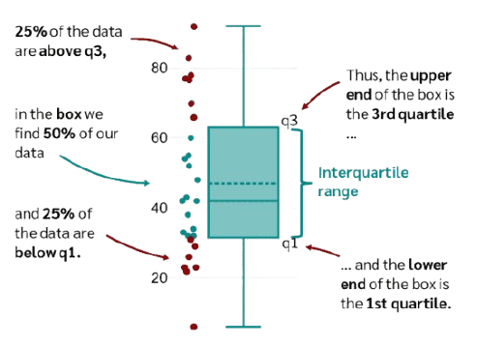
What is Box & Whiskers?
Not me!
A box plot shows how data is spread out — it helps you see if values are clustered, spread evenly, or have outliers
It uses five numbers: minimum, 25th percentile (q1), median (q2), 75th percentile (q3), and maximum
The box shows the middle 50% (aka IQR, interquartile range) of values, and the lines ("whiskers") show the full range, highlighting any values far outside the norm
Source: DataTab
For more in-depth explanation, refer to
https://datatab.net/tutorial/box-plot

Slide 44
What is Box & Whiskers for?
Use cases | Examples | Purpose
Retail sales | See which store locations have very high or very low daily sales compared to others | To take necessary preventive measures on store operations
Customer orders | Check the spread of order sizes | To find typical purchase amounts and unusually large or small orders
Delivery times | Compare how long deliveries take across different couriers or branches | To spot delays or inconsistency
Employee performance | Visualize how many tasks employees complete | To find the average worker and spot top or struggling performers
Website response times | Track how fast your website loads at different times | To identify when the website is the slowest or most stable

Slide 45
DAX Patterns for Box & Whiskers
MINIMUM
Min =
MIN('table'[Column])
MAXIMUM
Max =
MAX('table'[Column])
MEDIAN (q2)
Median =
MEDIAN('table'[Column])
Quartile 1 (q1)
Quartile1 = PERCENTILE.INC(data[Col], 0.25)
Quartile 3 (q3)
Quartile3 =
PERCENTILE.INC(data[Col], 0.75)
Quartiles: Note the changes are only the number, either 0.25 or 0.75

Slide 46
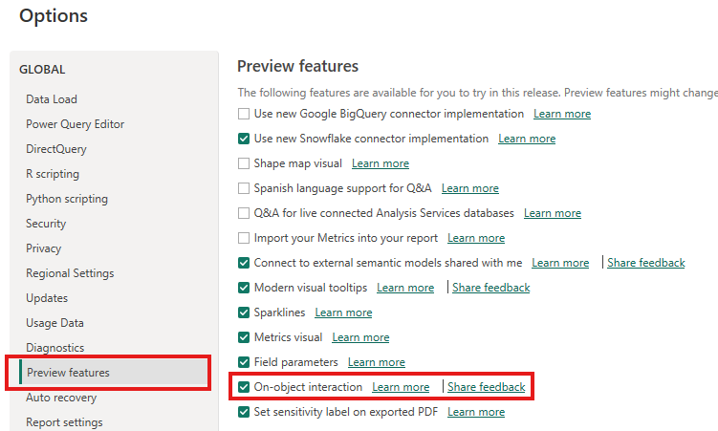
LAB 3B: Understanding spread & identifying anomalies in Crude Palm Oil Refinery (Purchases) Dataset
SETTING UP
We will be exploring the use of native visual (Line & stacked column chart), please turn on On-object interaction to enable certain features
YOUR TASK
Using slicers, filters, and tooltips to segment and explore patterns
Visual profiling (boxplots, histograms, scatterplots)
Identifying skewness and outliers visually
Tips: As this would involve a lot of DAX, it is advisable to create a “DAX folder” to store all your measures. Simply create an empty table (from Enter Data), and call it “MyMeasures”
Boxplot tutorial: https://www.youtube.com/watch?v=u6JVQKj5ijU&t=653s&ab_channel=HowtoPowerBI

Slide 47
LAB 3B: Creating boxplot in Power BI (1/7 – Set up)
Create Min, Max, First Quartile, Median, Third Quartile, Mean
Add line & stacked column chart into the canvas
Add [median] into Line y-axis and Plant[Region], into X-axis
Add markers, edit markers to show a dash, increase pixel width of the markers
Disable the connecting lines of the line chart by turning off Show for all series
Set Y-axis and Secondary y-axis minimum value to 0
Start adding [max] and [min] into Line y-axis
Remove titles in all axes (for secondary y-axis, you may need to toggle title off/on to remove it)
Change the marker for [median] to a different shape (e.g.: diamond), reduce pixel size
Boxplot tutorial: https://www.youtube.com/watch?v=u6JVQKj5ijU&t=653s&ab_channel=HowtoPowerBI

Slide 48
LAB 3B: Creating boxplot in Power BI (2/7 – Including error bars for whiskers)
Enable “Error bars”, and select [max] for “Upper bound”, and [min] for “Lower bound”
Ensure “Bar” is turned on to view the vertical lines
Boxplot tutorial: https://www.youtube.com/watch?v=u6JVQKj5ijU&t=653s&ab_channel=HowtoPowerBI

Slide 49
LAB 3B: Creating boxplot in Power BI (3/7 – Stacking columns)
Almost there!
Create [iqr] measure
[iqr] = [quartile3] - [quartile1]
Drag the [quartile1] measure into Column y-axis, and [iqr] above it (stacked)
Under Columns > Color, select [quartile1] and turn the column color white, and the [iqr] color to a lighter grey
Boxplot tutorial: https://www.youtube.com/watch?v=u6JVQKj5ijU&t=653s&ab_channel=HowtoPowerBI

Slide 50
LAB 3B: Creating boxplot in Power BI (4/7 – Rename legends)
Hide the [quartile1] legend by renaming the field to a space
Boxplot tutorial: https://www.youtube.com/watch?v=u6JVQKj5ijU&t=653s&ab_channel=HowtoPowerBI

Slide 51
LAB 3B: Creating boxplot in Power BI (5/7 – Customise y-max)
Since we hard-coded maximum values for y-axes (primary and secondary), now we want to make that axis dynamic, so it is going to change based on the slicers we select
To do that, we create another measure [y-max] by using the following function
y-max = [max] * 1.2 // any other factor works too, depending on scale in the visual
Boxplot tutorial: https://www.youtube.com/watch?v=u6JVQKj5ijU&t=653s&ab_channel=HowtoPowerBI

Slide 52
LAB 3B: Creating boxplot in Power BI (6/7 – Create dynamic y-axes)
Much meow!
Add this [y-max] to both Y-axis and Secondary y-axis maximum values using the fx button in the formatting panel
Boxplot tutorial: https://www.youtube.com/watch?v=u6JVQKj5ijU&t=653s&ab_channel=HowtoPowerBI

Slide 53
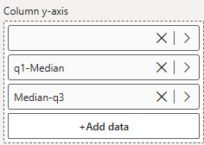
LAB 3B: Creating boxplot in Power BI (7/7 – Splitting IQR into 2 segments)
Good job!
Since it might be difficult to read the chart without a line separating the top half and bottom half of the IQR, we need to split the IQR
[iqr 25-50] = [median] – [q1]
[iqr 50-75] = [q3] – [median]
Replace the IQR with the respective measures in the right order
Edit the colors
Now let’s have fun with adding a slicer for region/subregion, and put your thinking hat for some analysis! Yes, of course we can use ChatGPT to help us to interpret things we don’t understand.
Tips: You may include Refinery[City] and Refinery[Mill Name] into the hierarchical breakdown in X-axis to interact with the region/subregion slicers
Boxplot tutorial: https://www.youtube.com/watch?v=u6JVQKj5ijU&t=653s&ab_channel=HowtoPowerBI

Slide 54
MILESTONE 3 AGENDA
Milestone 2 Recap
Revisiting SDG’s data model - Statistical Scenarios and Report Building
RFM Model - Segmentation & insight automation

Slide 55
LAB 3C: Understanding correlation between Estate Production and Refinery Purchases datasets
YOUR TASK
Using the same data model, create [yield] measure for Production dataset
Visual profiling (histograms, scatterplots)
Discuss findings, Q&A

Slide 56
LAB 4A: Build a DAX-driven report (Sales Trend)
Calculation of ratios, change metrics, rolling averages beyond simple measures

Slide 57
LAB 4B: Build a DAX-driven report (RFM, cohort logic)
Nested IFs, SWITCH, custom ranking logic
Calculation of ratios, change metrics, rolling averages beyond simple measures
Creating logic for market basket insights

